Slide 1

MAULANA AZAD
NATIONAL INSTITUTE OF TECHNOLOGY
BHOPAL, INDIA, 462003
DEPARTMENT OF COMPUTER SCIENCE & ENGINEERING
TEAM MEMBERS
Archit Badola | 201112278
Shubham Singh | 201112251
Saurav Pawar | 201112253
Prabhudeba Nath | 201112203
FACULTY
Project Mentor | Dr. Vaibhav Soni
Project Expert | Dr. Vijay Bhaskar Semwal

Slide 2
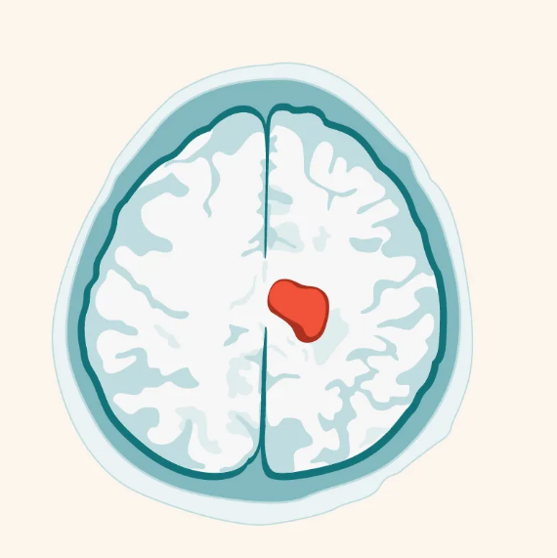
Brain Tumor classification using
Deep Learning Approach

Slide 3
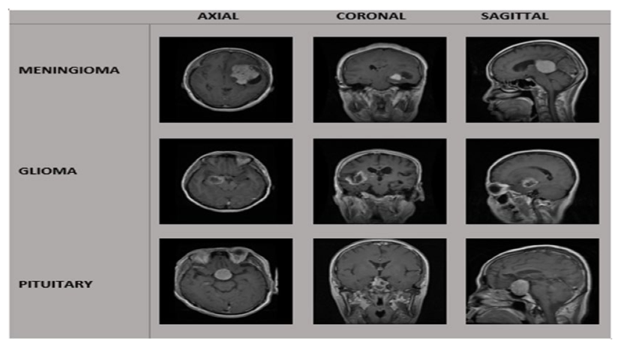
About Brain Tumor:
Brain tumor is a disorder caused by the growth of abnormal growth of brain cells. It is a life threatening disease whose early detection is important.
There are over 120 brain tumor types,based on the brain tissues they affect; not all brain tumors are brain cancer.
Three types of brain tumors:
1. Meningioma
2. Glioma*
3. Pituitary
*The glioma tumors can be further differentiated into three grades (Grade II , Grade III and Grade IV).
Fig 1: MRIs of types of brain tumor

Slide 4
Why Machine Learning?
These tumors can be identified through Magnetic Resonance (MRI) Images. The classification of brain tumor through MRI images is the first important thing in successful implementation of treatment.
Manual classification is a time consuming and challenging procedure and can cause errors. Challenging task for medical personnels because of its complexities and minuteness.
Adoption of computer-assisted approach using deep learning (DL) models is essential to overcome the constraints.

Slide 5
Dataset:
This study includes publicly available CE-MRI Dataset.
Size: 840MB
Includes MRI Images of 233 patients.
Dataset includes total 3064 MRI Images
Gliomas (1426)
Meningiomas (708)
Pituitary (930)
Source: https://figshare.com/articles/dataset/brain_tumor_dataset/1512427

Slide 6
S.no | Title | Journal | Year | Findings
1. | A Hybrid Deep Learning-Based Approach for Brain Tumor Classification | Electronics | 2022 | GoogleNet gave highest accuracy of 98.26% on CE-MRI dataset. Modifying output layers of GoogleNet yields better results
2. | Brain Tumor Classification for MRI images using transfer learning and fine-tuning | Computerized Medical Imaging and Graphics | 2019 | Training deep CNN from scratch is a challenging task. For small dataset scenario, a pre-trained CNN saves time and resources.
Notes:
1: GoogleNet architecture can be used as base for Brain Tumor classification as it gave highest ever accuracy of 99.67% on CE-MRI dataset.
2: Training deep CNN from scratch is a challenging task that is tedious and demands much diligence and patience. For small dataset scenario, a favorable substitute for training CNN from scratch is to use a pre-trained CNN based on transfer learning and fine-tuning strategy

Slide 7
3. | Multi Classification of brain tumor images using deep Neural Network | Special Section On Deep Learning For Computer-Aided Medical Diagnosis | 2019 | Image Pre-processing drastically improves the training of model and increase accuracy. Data augmentation helps in showing better results and solve problem of small dataset.
Notes:
3: Image Pre-processing and proper tuning of parameters can drastically improve the training of model and increase accuracy.

Slide 8
Research Gaps:
The proposed models in the papers need to be tested on a large scale datasets that include different ages to increase its portability and extend it in other medical applications.
Less work has been done with 3D MRIs for classification of brain tumor as the size of 3D MRIs dataset are large and there is lack of extensive studies.
Different combination of parameters and layers must be tested to check best suited models.
Further classification of glioma tumors ( Grade II , Grade III and Grade IV ) has not been explored in most research papers.

Slide 9
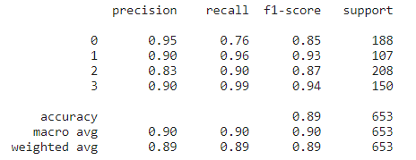
Methodology:
Model 1: GOOGLENET ARCHITECTURE
It is convolutional neural network that is 22 layers deep.
Used CE-MRI Dataset containing 3062 MRI’s for training and testing of model.
We ran 100 epochs on the dataset and got the below performance metrics.
Test Set Accuracy: 89%
Fig 2: Classification report of ‘Model 1’

Slide 10
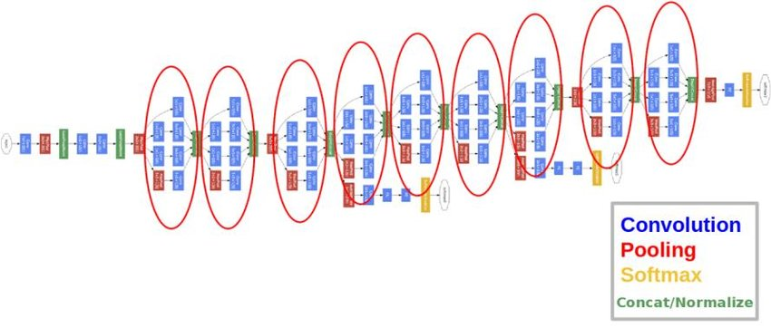
GOOGLENET ARCHITECTURE
Fig 3: GoogleNet Architecture

Slide 11
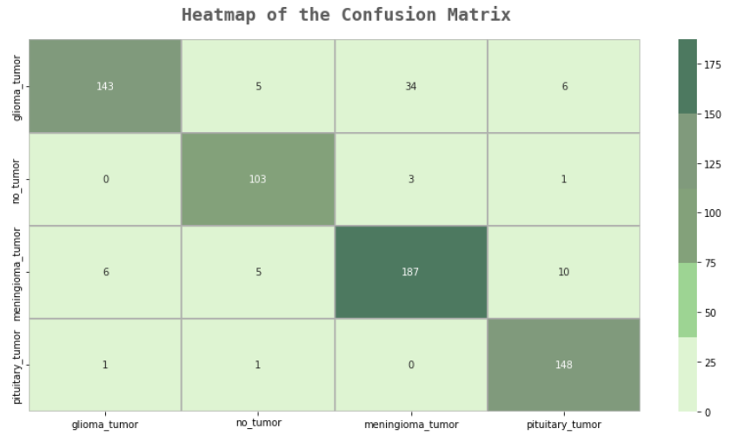
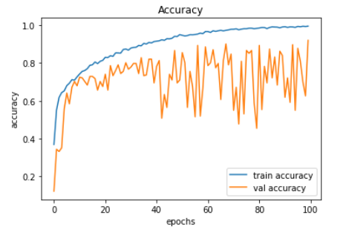
Fig 4: Confusion matrix of Model 1
Fig 5: Accuracy curve of Model 1

Slide 12
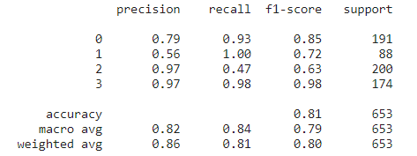
Model 2 : GOOGLENET ARCHITECTURE WITH ADDITIONAL LAYERS
Used GoogleNet architecture as the base model for this model.
Removed 5 layers and added 15 layers to the GoogleNet architecture.
Used CE-MRI Dataset containing 3062 MRIs for training and testing of model.
We ran 100 epochs on the dataset and got the below performance metrics.
Test Set Accuracy: 81%
Fig 6: Classification report of ‘Model 2’

Slide 13
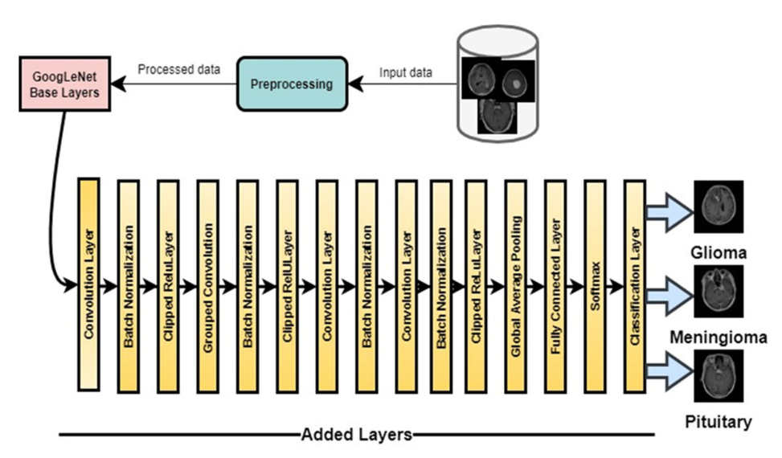
ARCHITECTURE OF MODEL 2
Fig 7: Proposed Model

Slide 14
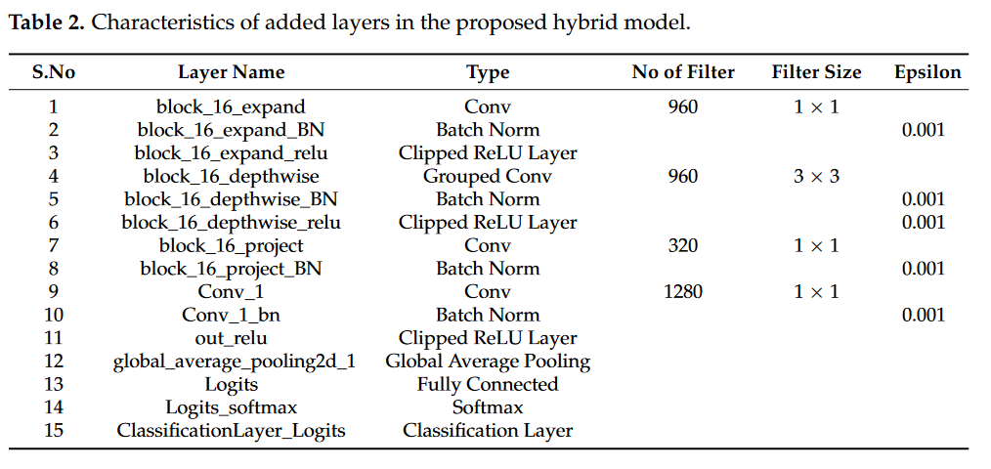
Characteristics of 15 added layers
Fig 8: Layers added in the proposed model

Slide 15
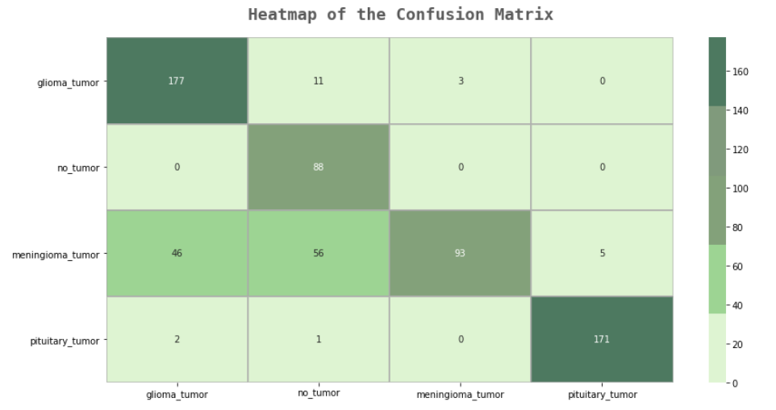
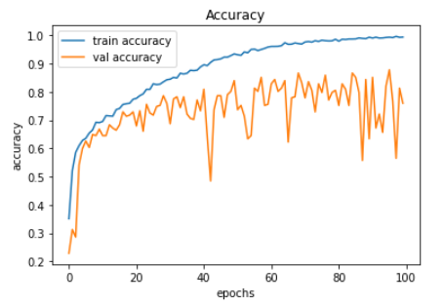
Fig 9: Confusion matrix of Model 2
Fig 10: Accuracy curve of Model 2

Slide 16
Observations:
After applying all models on the dataset, GoogleNet architecture has given the highest accuracy.
The main problem we observed was that the model tends to overfit the data, which reduces the testing accuracy.
This problem can be reduced using:
a. Regularization
b. Reducing model complexity
c. Using dropout layers

Slide 17
Conclusion:
The proposed model can be used for brain tumor detection and classification to help medical experts provide proper and timely treatment to the patients.
Giving an accuracy of 89%, this model with further advancements is capable of accurately predicting and classifying brain tumors from MRI images.

Slide 18
Future Work:
We can improve the accuracy and make more precise ML models to use them in medical domain with additional layers and larger dataset.
Various other permutations of activation layers and modified CNN models need to be tested on CE-MRI dataset.
CNN models would be modified to work on 3D datasets.
The depth of classification by further classification of glioma tumors ( Grade II, Grade III and Grade IV ) shall be increased.

Slide 19
Technology used:
Modules and libraries used:
Python
Kaggle
Google Colab
Machine Learning
Transfer Learning
We used following python libraries:
Numpy
Pandas
Matplotlib
Seaborn
Cv2
Tensorflow
sklearn

Slide 20
References:
[1]Raza, A., Ayub, H., Khan, J.A., Ahmad, I., S Salama, A., Daradkeh, Y.I., Javeed, D., Ur Rehman, A. and Hamam, H., 2022. A Hybrid Deep Learning-Based Approach for Brain Tumor Classification. Electronics, 11(7), p.1146.
[2]Kumar, S. and Mankame, D.P., 2020. Optimization driven deep convolutional neural network for brain tumor classification. Biocybernetics and Biomedical Engineering, 40(3), pp.1190-1204.
[3]Swati, Z.N.K., Zhao, Q., Kabir, M., Ali, F., Ali, Z., Ahmed, S. and Lu, J., 2019. Brain tumor classification for MR images using transfer learning and fine-tuning. Computerized Medical Imaging and Graphics, 75, pp.34-46.
[4]Sultan, H.H., Salem, N.M. and Al-Atabany, W., 2019. Multi-classification of brain tumor images using deep neural networks. IEEE access, 7, pp.69215-69225.
[5]Aurna, N.F., Yousuf, M.A., Taher, K.A., Azad, A.K.M. and Moni, M.A., 2022. A classification of MRI brain tumor based on two stage feature level ensemble of deep CNN models. Computers in Biology and Medicine, 146, p.105539.
[6]Shah, H.A., Saeed, F., Yun, S., Park, J.H., Paul, A. and Kang, J.M., 2022. A Robust Approach for Brain Tumor Detection in Magnetic Resonance Images Using Finetuned EfficientNet. IEEE Access, 10, pp.65426-65438.

